Slide 1
Design Patterns
Strategy Pattern

Slide 2
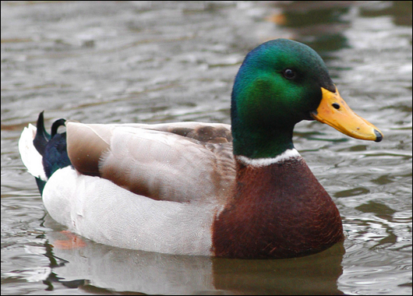
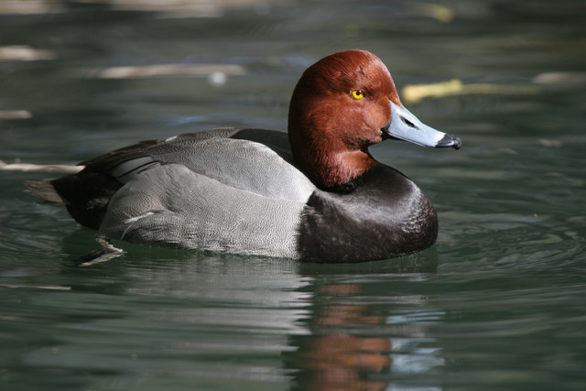
Let’s Design a Duck!
There are two types of duck
Mallard
Red Headed Duck
Both types of duck swim and quack
Both types of duck can print their details

Slide 3
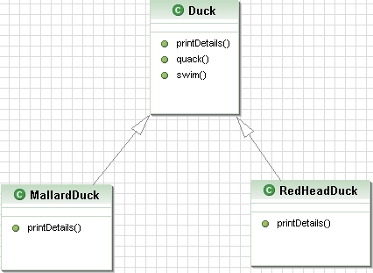
Design that duck!
Did your design look like this?

Slide 4
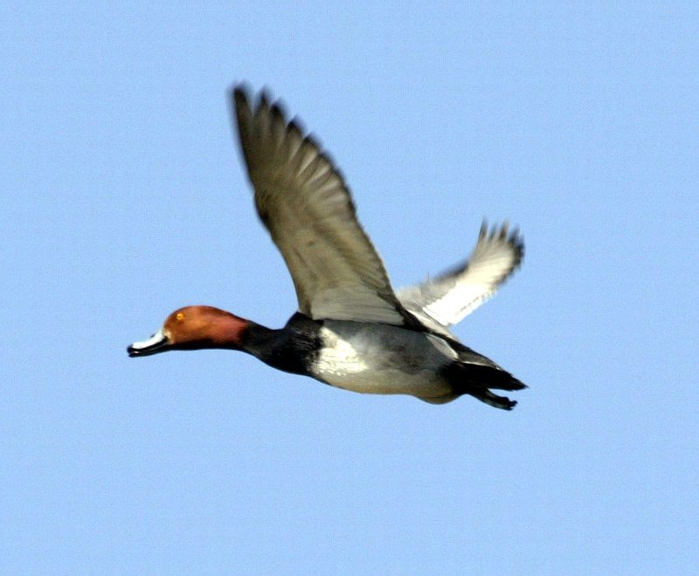
Ducks fly
Watch

Slide 5
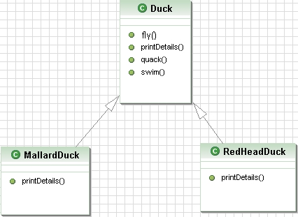
Flying Ducks
We need to add a method to the class Duck

Slide 6
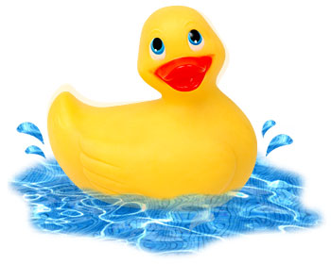
More Ducks
I have just remembered another type of duck

Slide 7
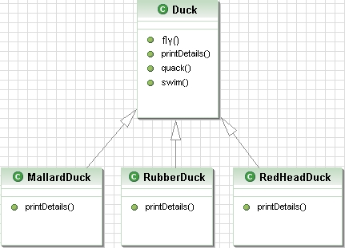
Let’s Add a New Class
Now we have a problem
A local update to the code as caused a non-local side effect

Slide 8
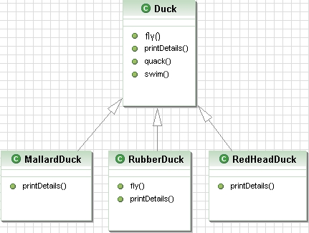
We Need a Solution
Override the method

Slide 9
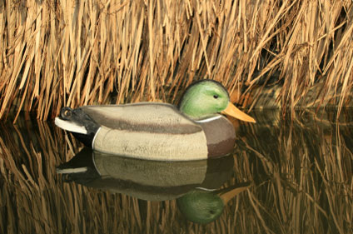
More Ducks
Decoy duck
Can’t fly
Doesn’t quack

Slide 10
Decoy Duck Facts
According to Wiki
The current World Record price for an antique duck decoy at auction is $856,000
The first million dollar price was achieved when two decoys (Canadian goose and a preening pintail drake) were sold for US$1.13 million dollars each in a private sale.
The record-setting decoys were sold in a larger collection of 31 decoys for $7.5 million in total so it remains for a single decoy to clearly break the $1 million mark

Slide 11
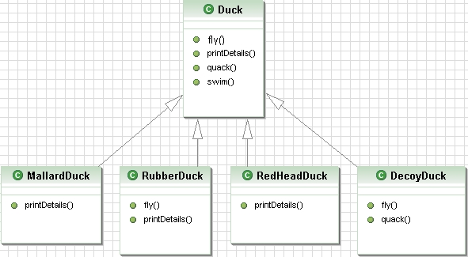
Let’s Create the Class
We must override fly() and quack()
This design isn’t working out!

Slide 12
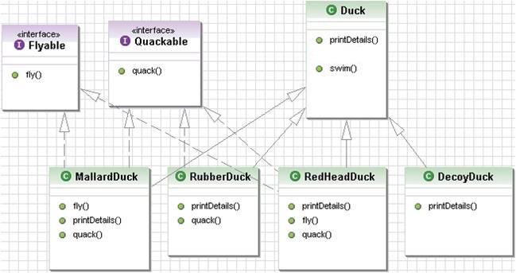
Interfaces
How about using an interface

Slide 13
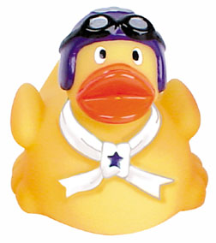
Interfaces
We have solved one problem
No flying rubber ducks!
But created another ...
... No code reuse

Slide 14
Software Development
In software development there is one thing you can always rely on ....
CHANGE

Slide 15

Design Principle
Identify the aspects of your application that vary and separate them from what stays the same.

Slide 16
Design Principle
Program to the interface, not an implementation
Great... but what does that mean

Slide 17
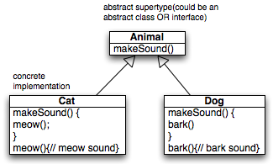
Design Principle
Programming to an implementation
//Declare the variable “d” as type Dog
(a concrete implementation of Animal
forces us to code to a concrete
implementation)
Dog d = new Dog();
d.bark();
Programming to an interface/supertype
// We know it’s a Dog, but we can now use the animal reference polymorphically
Animal animal = new Dog();
animal.makeSound();
Assign the concrete implementation object at runtime
// We don’t know WHAT the actual animal subtype is... all we care about is that it knows how to respond makeSound().
Animal a = getAnimal();
a.makeSound();

Slide 18
Back to the ducks...
We know that fly() and quack() are the parts of the Duck class that vary across ducks
To separate these behaviours we remove the methods from the Duck class and create new set of classes to represent each behaviour

Slide 19
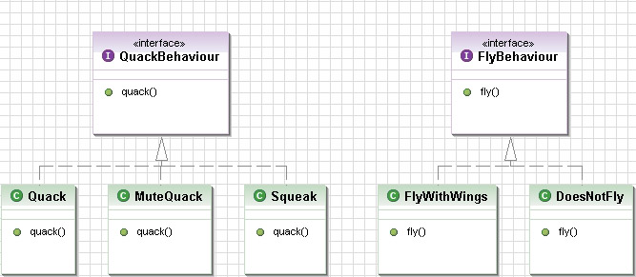
Implementing the
Duck Behaviours

Slide 20
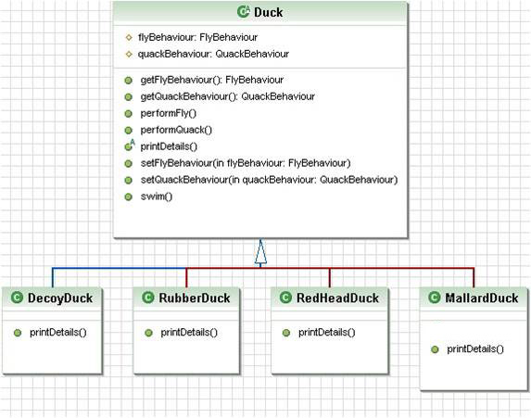
Ducks
Now we integrate the Duck’s behaviour

Slide 21
Link the Duck to its Behaviour
public abstract class Duck {
  protected FlyBehaviour flyBehaviour;
protected QuackBehaviour quackBehaviour;
// getters and setters
public FlyBehaviour getFlyBehaviour() {
return this.flyBehaviour;
}
public void setFlyBehaviour(FlyBehaviour flyBehaviour) {
this.flyBehaviour = flyBehaviour;
}
.....
}

Slide 22
Make the Duck Quack & Fly
public abstract class Duck {
public void performQuack(){
this.quackBehaviour.quack();
}
public void performFly() {
this.flyBehaviour.fly();
}
....
}

Slide 23
Set the Default Behaviour
public class MallardDuck extends Duck{
  public MallardDuck() {
this.flyBehaviour = new FlyWithWings();
this.quackBehaviour = new Quack();
}
....
}

Slide 24
Create a Mallard
public class StrategyDemo {
public static void main(String[] args) {
Duck mallard = new MallardDuck();
mallard.performQuack();
mallard.performFly();
}
}

Slide 25
Dynamically Change Behaviour
public class StrategyDemo {
public static void main(String[] args) {
Duck mallard = new MallardDuck();
mallard.performFly();
mallard.setFlyBehaviour(new DoesNotFly());
mallard.performFly();
}
}

Slide 26
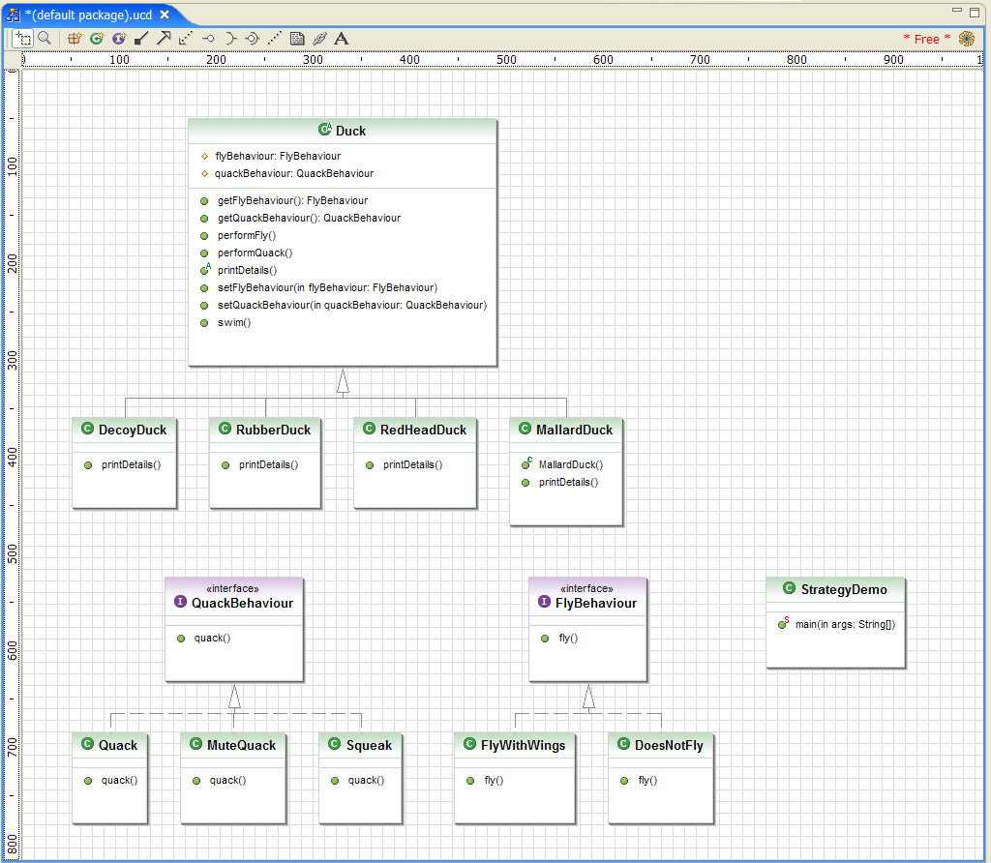

Slide 27
Patterns
That is the Strategy Pattern

